Slide 1

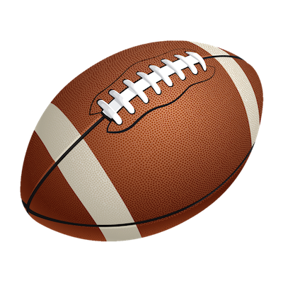
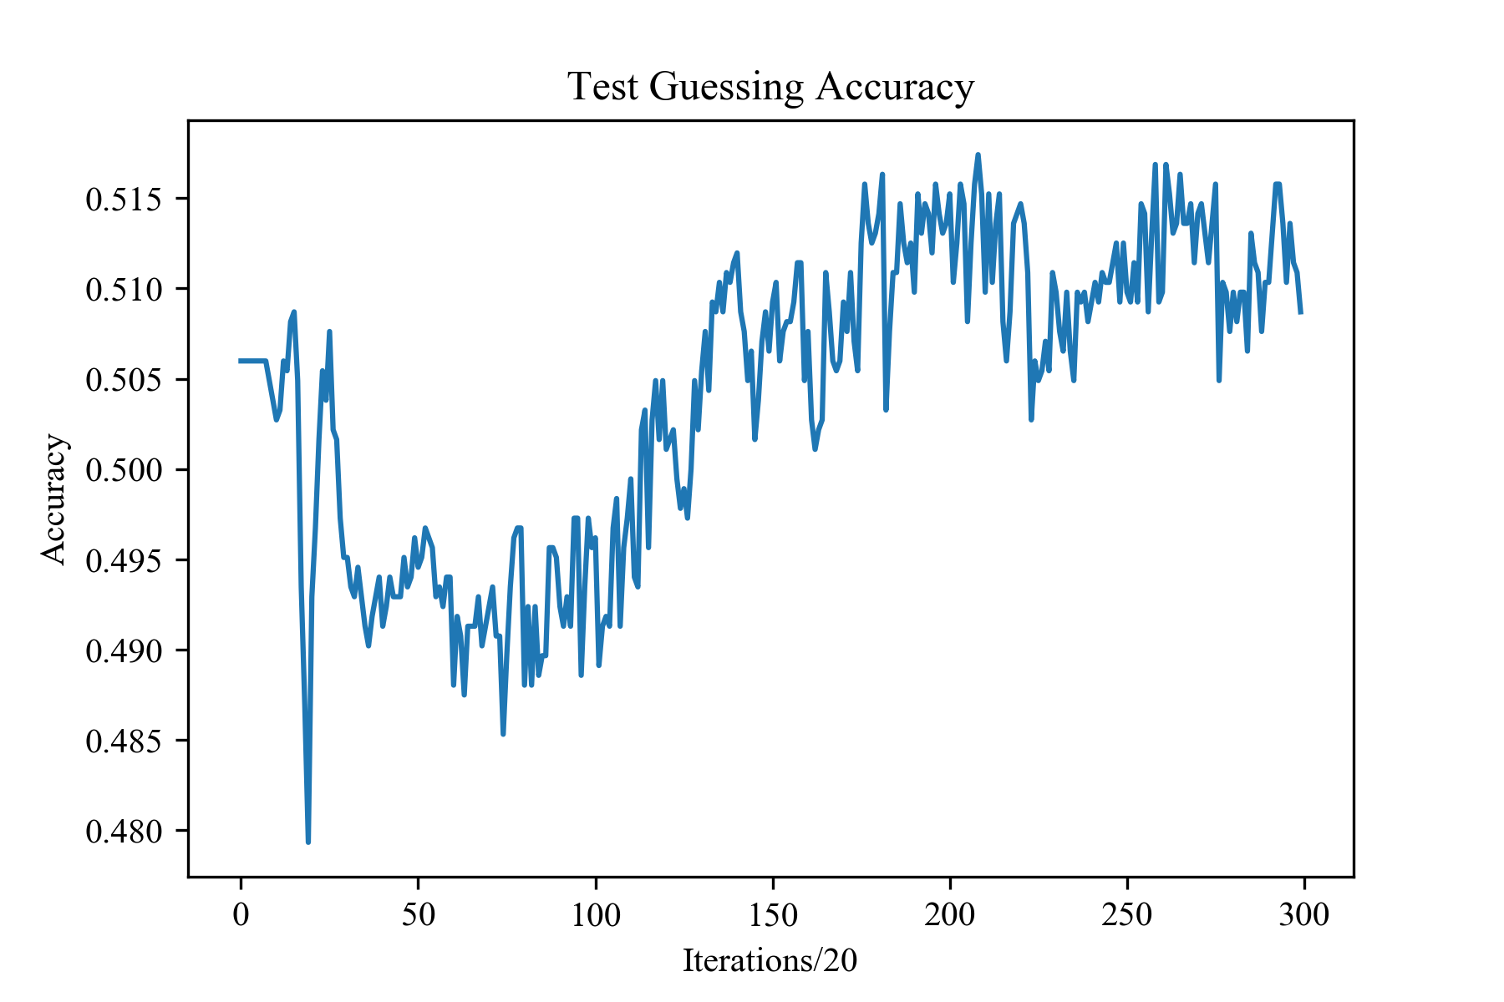
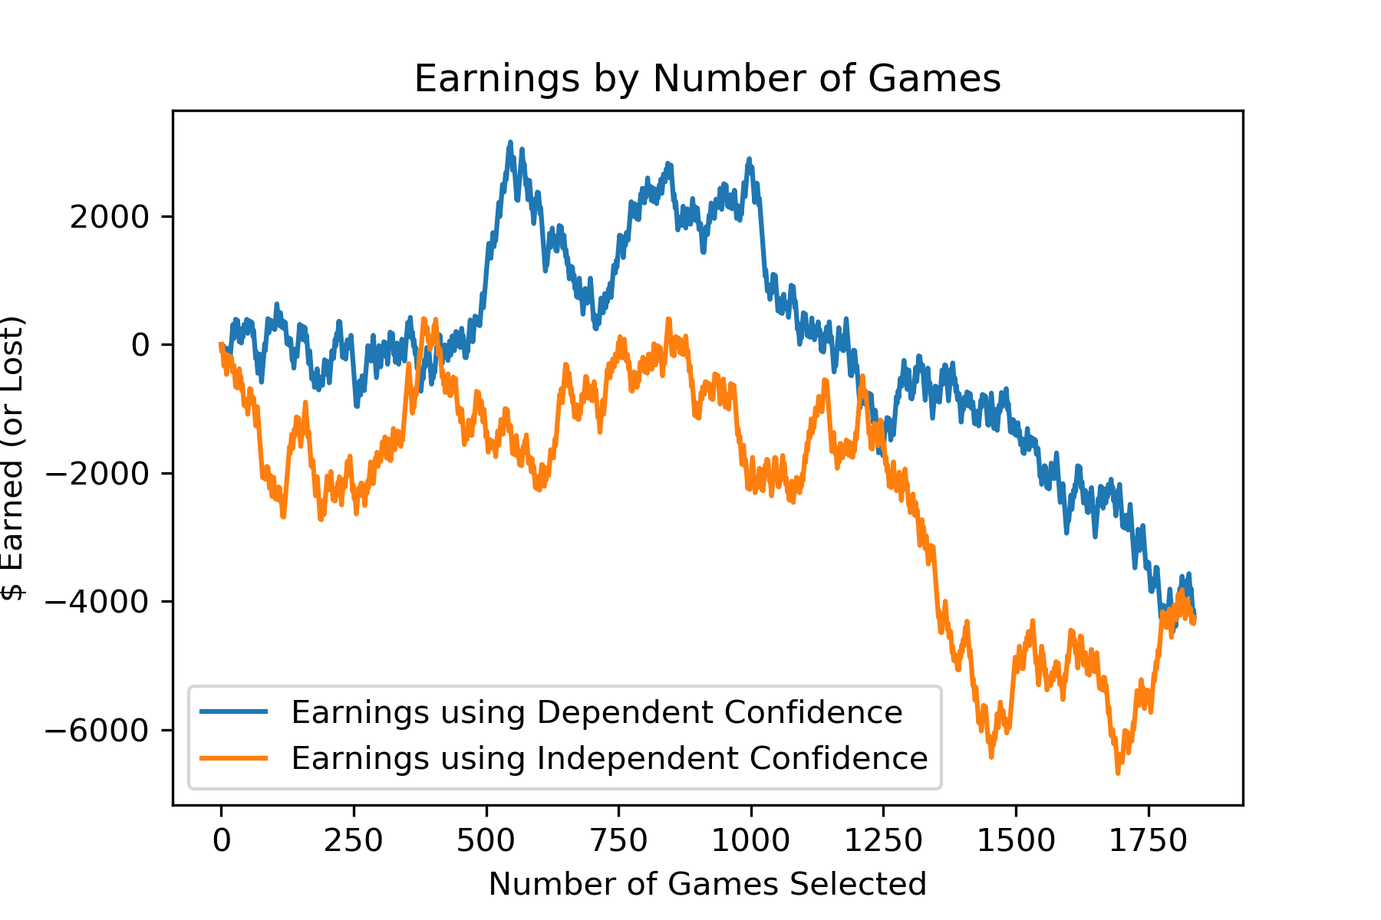
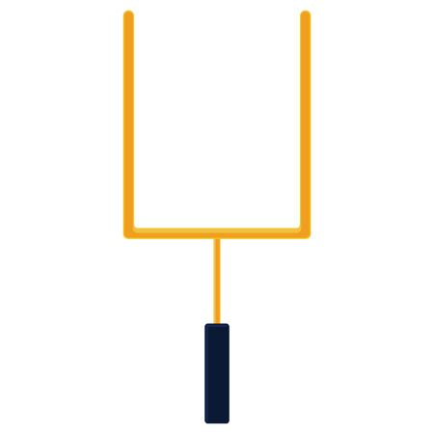
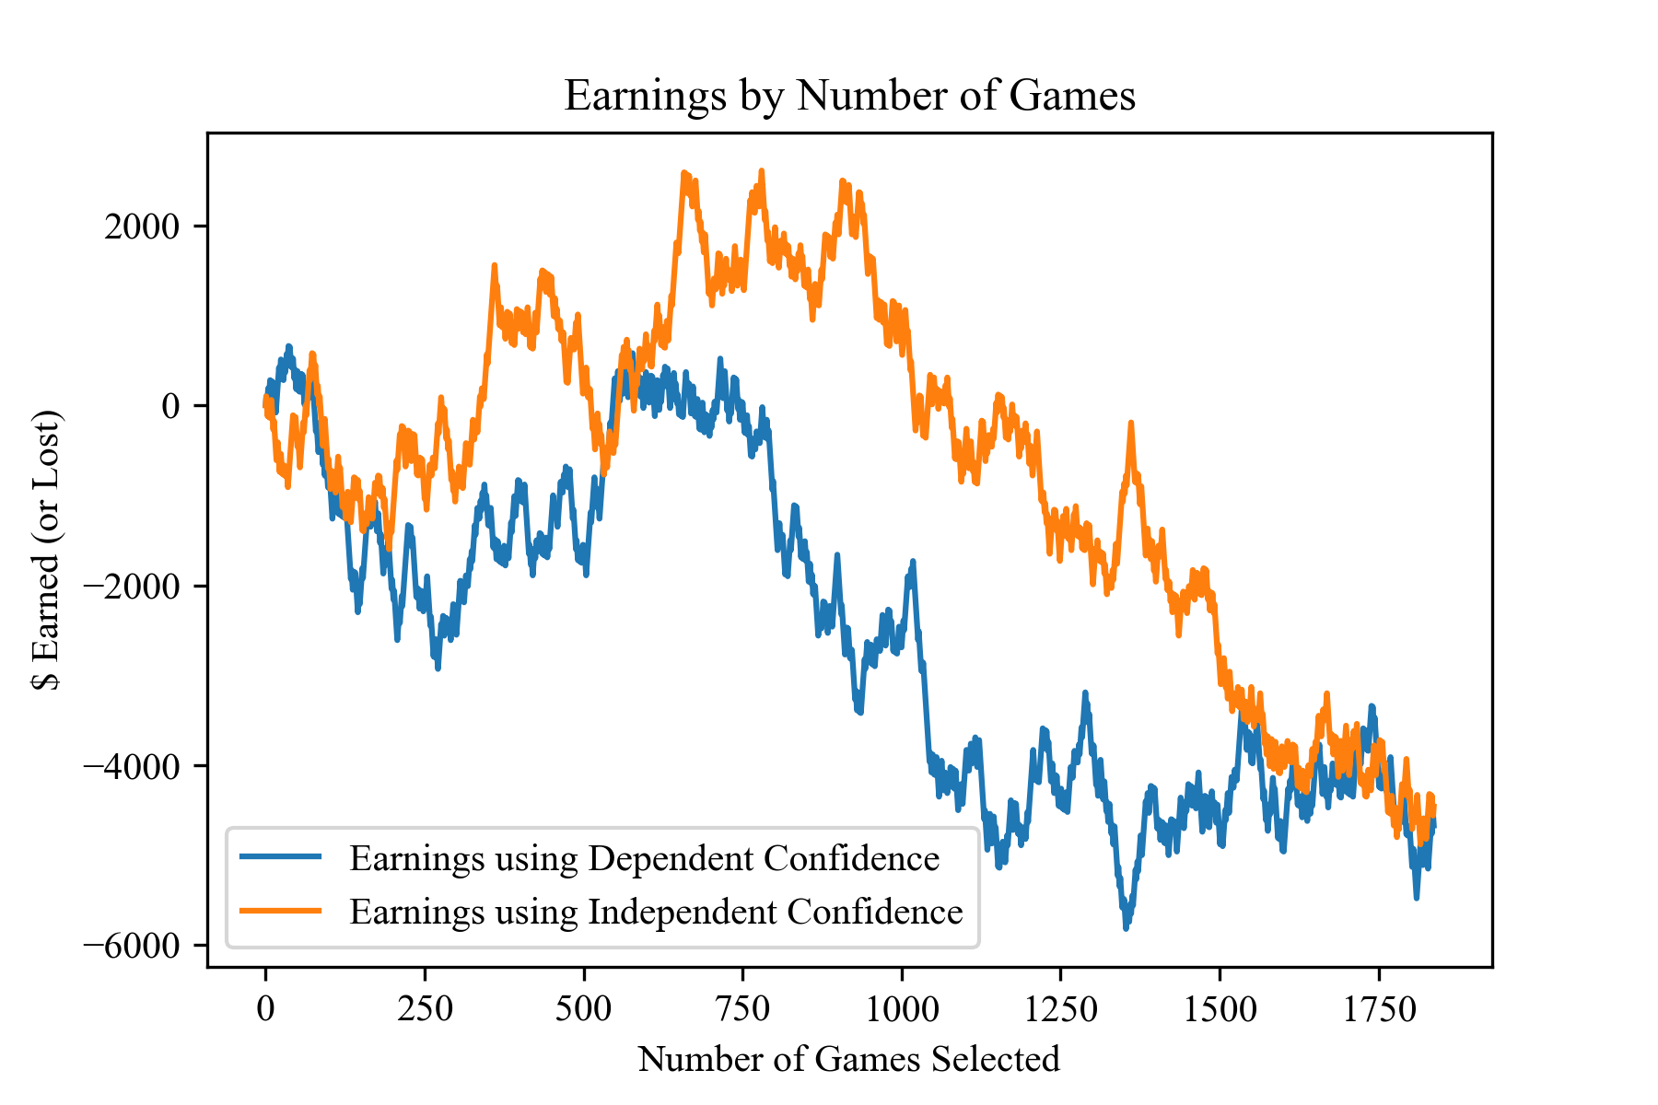
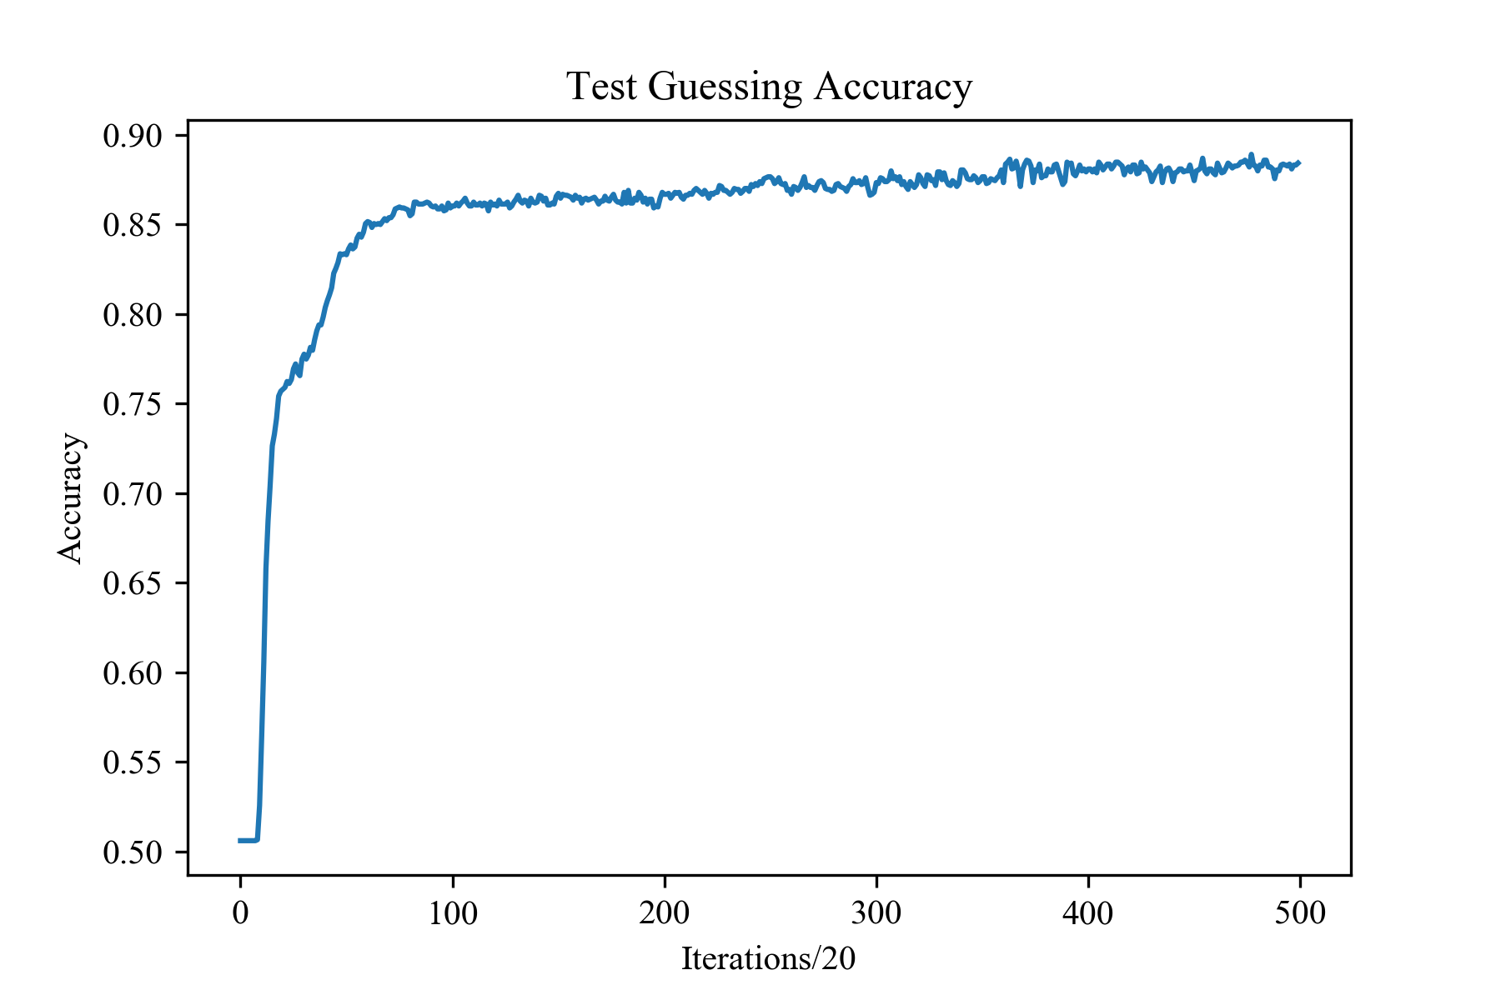
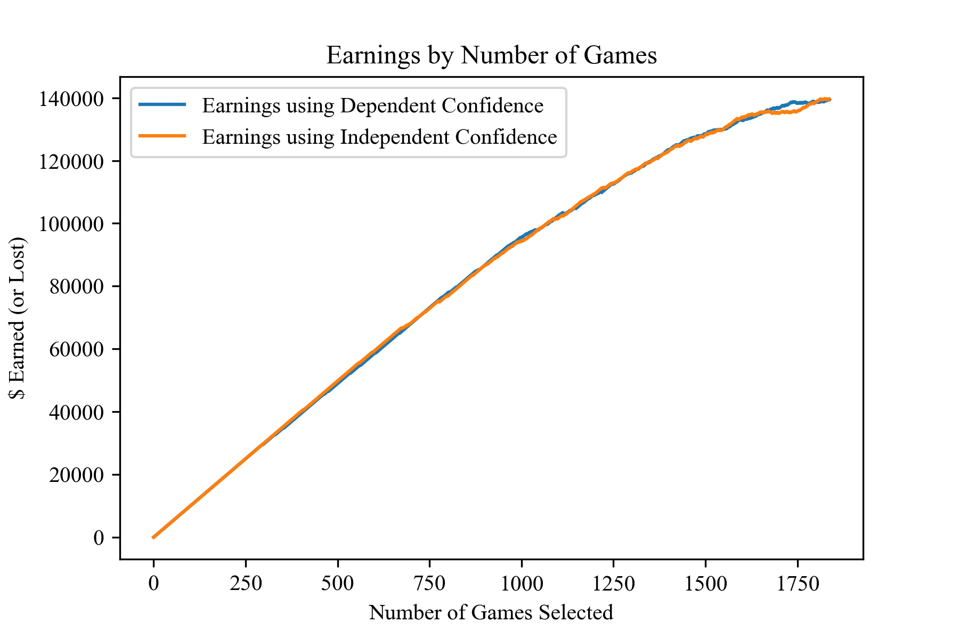
Sports Betting using Neural Networks Aaron Williams Department of Electrical and Computer Engineering, Duke University
Introduction
Hyper Parameterization
Results
Can we use neural networks (NN) to make informed betting decisions? Can we make money consistently doing so? I hope to answer these questions by using data to make predictions on College Football scoring spreads.
Need correct amount of statistical and recruiting data per datapoint.
Limited by amount of proceeding data.
Tests done on two fully connected dense layers, no activation function.
All subsequent tests were done with 10 past games and 4 past years.
If we bet in all games, accuracy needs to be just 52.4% to account for a $100 return on a pay of $110.
Accuracy is typically around 51.5% and can be highly variable through training.
Dependent is distance from 0.5 in determiner. Independent is a NN which takes determiner as input and all other data.
Neither performs better consistently. There is some trend towards better performance earlier on, but not enough for reliable betting.
Losses for betting on all games average around $4000.
Create an adequate estimate of the scoring differential between two teams.
Guess the spread using statistical + recruiting data.
Use that information to estimate which way we should bet against the spread.
Estimate confidence in these guess.
Start accruing a small fortune.
Predictions and Convolutions
Actual Lower Bound: 16.83
Spread versus Actual: 12.55
2-Layer FC NN | Betting Spread | Actual Difference
Prediction on Spread | Avg ± of 4.52 | Avg ± of 13.25
Prediction on Actual | Avg ± of 5.24 | Avg ± of 13.38
Data
With Convolutions | Betting Spread | Actual Difference
Prediction on Spread | Avg ± of 4.55 | Avg ± of 13.24
Prediction on Actual | Avg ± of 4.92 | Avg ± of 13.25
There are limitations in data, but sources were determined for betting information, game by game statistics, and recruiting.
Statistics
Rush Yards per Game
Rush Attempts per Game
Pass Yards per Game
Pass Attempts per Game
Pass Comps per Game
Fumbles per Game
Interceptions per Game
Final Score
Recruiting
Number of Recruits
Number of 5-stars
Number of 4-stars
Number of 3-stars
Average Ranking
Overall Score (by Rivals)
Lower Bound is the average absolute difference against mean.
The spread performs better than both NNs by a significant margin. Both networks predict the spread better than Actual.
No significant advantages for Convolution.
Additional importance measures show convolution and flat vectors equally retain information.
Conclusions/Analysis
Not enough Data: Could of used injury reports, off-field drama, coaching changes, or even weather to indicate the outcome of a game.
Training: It’s easy to find relevant information for an upcoming game, but how do you apply that to a trained NN? How do you train a NN with data not found historically?
RNN: Applying an RNN to this problem might have merit. Retroactive Adjustments would be the main difficulty.
Over/Under: It might have been better to try and solve over/under instead of the spread. Statistics are generally more relevant to total scoring.
Closing: I was hoping this
project would be a little
more interesting, either as
a result of the network
architecture or the
independent confidence
metric. Images next time.
Betting Information
Spread
Over/Under
False Results
Included for fun. What if we could see the future and knew the game scores, but only needed to guess the betting spread?
Training Data includes 2003 – 2014 (7684 datapoints)
Test Data Includes 2015 – 2017 (1838 datapoints)
Each value (besides spread) was 0-normed with respect to the training data.
All data points include the opposing team’s statistics, and the average statistics of the opponent’s last 10 games.
Also Game/(Total Games in Year) was included.
References:
Chernoff, A. (2017, August 30). How To Create And Use NFL Power Ratings To Beat The Point Spread. Retrieved from https://medium.com/@adamchernoff/how-to-create-and-use-nfl-power-ratings-to-beat-the-point-spread-3fa4c3ecdc22
A machine learning framework for sport result prediction. (2017, September 19). Retrieved from https://www.sciencedirect.com/science/article/pii/S2210832717301485
Thomas, Eduorard. “Beat the Bookmakers with Machine Learning (Tennis).” RSNA Pneumonia Detection Challenge | Kaggle, www.kaggle.com/edouardthomas/beat-the-bookmakers-with-machine-learning-tennis.
http://sports.snoozle.net/search/fbs/index.jsp
https://n.rivals.com/team_rankings/2019/all-teams/football
https://www.masseyratings.com/
https://github.com/mattp88/ncaa/blob/master/teams.cs
We’d want to invest a lot more than $100 in each game.

